Slide 1

Chapter 3 Transport Layer
A note on the use of these PowerPoint slides:
We’re making these slides freely available to all (faculty, students, readers). They’re in PowerPoint form so you see the animations; and can add, modify, and delete slides (including this one) and slide content to suit your needs. They obviously represent a lot of work on our part. In return for use, we only ask the following:
If you use these slides (e.g., in a class) that you mention their source (after all, we’d like people to use our book!)
If you post any slides on a www site, that you note that they are adapted from (or perhaps identical to) our slides, and note our copyright of this material.
For a revision history, see the slide note for this page.
Thanks and enjoy! JFK/KWR
All material copyright 1996-2020
J.F Kurose and K.W. Ross, All Rights Reserved
Computer Networking: A Top-Down Approach 8th edition Jim Kurose, Keith Ross Pearson, 2020
Notes:
Version History
8.0 (April 2020)
All slides reformatted for 16:9 aspect ratio
All slides updated to 8th edition material
Use of Calibri font, rather that Gill Sans MT
Add LOTS more animation throughout
added new 8th edition material on QUIC, CUBIC, delay-based congestion control
lighter header font

Slide 2
Performance of rdt3.0 (stop-and-wait)
U _{sender}: utilization – fraction of time sender busy sending
example: 1 Gbps link, 15 ms prop. delay, 8000 bit packet
time to transmit packet into channel:
L
8000 bits
D_{trans} =
=
=
8 microsecs
R
10⁹ bits/sec
Notes:
if RTT=30 msec, 1KB pkt every 30 msec: 33kB/sec thruput over 1 Gbps link
network protocol limits use of physical resources
Let’s develop a formula for utilization

Slide 3
rdt3.0: stop-and-wait operation
sender
receiver
first packet bit transmitted, t = 0
first packet bit arrives
RTT
last packet bit arrives, send ACK
ACK arrives, send next
packet, t = RTT + L / R

Slide 4
rdt3.0: stop-and-wait operation
sender
receiver
L / R
=
L/R
U_{sender}
RTT
+ L / R
.008
RTT
=
30.008
=
0.00027
rdt 3.0 protocol performance stinks!
Protocol limits performance of underlying infrastructure (channel)

Slide 5
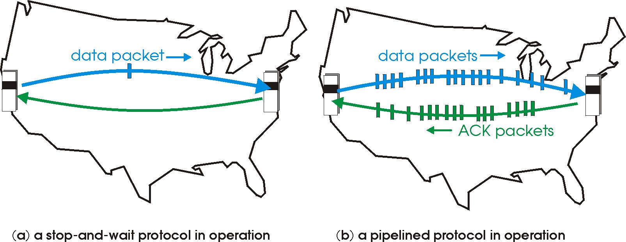

rdt3.0: pipelined protocols operation
pipelining: sender allows multiple, “in-flight”, yet-to-be-acknowledged packets
range of sequence numbers must be increased
buffering at sender and/or receiver

Slide 6
Pipelining: increased utilization
sender
receiver
first packet bit transmitted, t = 0
last bit transmitted, t = L / R
first packet bit arrives
RTT
last packet bit arrives, send ACK
last bit of 2nd packet arrives, send ACK
last bit of 3rd packet arrives, send ACK
ACK arrives, send next
packet, t = RTT + L / R
3-packet pipelining increases
utilization by a factor of 3!
Notes:
two generic forms of pipelined protocols: go-Back-N, selective repeat

Slide 7
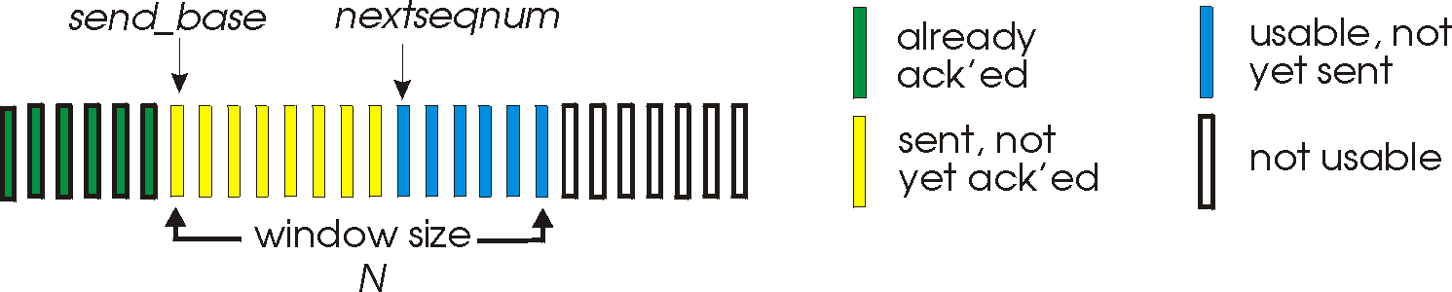
Go-Back-N: sender
sender: “window” of up to N, consecutive transmitted but unACKed pkts
k-bit seq # in pkt header
cumulative ACK: ACK(n): ACKs all packets up to, including seq # n
on receiving ACK(n): move window forward to begin at n+1
timer for oldest in-flight packet
timeout(n): retransmit packet n and all higher seq # packets in window
Notes:
window size of 14, 8 have been sent but are not yet ackowledgedm 6 sequence numbers are available for us. In woindow, but no calls from above to use them.
Note – we’ll skip the Go-Back-N FSM specification you can chack that out in powerpoitn slides or book)
TCP uses cumulative ACK

Slide 8
Go-Back-N: receiver
ACK-only: always send ACK for correctly-received packet so far, with highest in-order seq #
may generate duplicate ACKs
need only remember rcv_base
on receipt of out-of-order packet:
can discard (don’t buffer) or buffer: an implementation decision
re-ACK pkt with highest in-order seq #
Receiver view of sequence number space:
received and ACKed
…
…
Out-of-order: received but not ACKed
rcv_base
Not received
Notes:
Note – we’ll skip the Go-Back-N FSM specification (actually it’s

Slide 9

Go-Back-N in action
sender window (N=4)
sender
receiver
0 1 2 3 4 5 6 7 8
send pkt0
send pkt1
send pkt2
send pkt3
(wait)
0 1 2 3 4 5 6 7 8
receive pkt0, send ack0
receive pkt1, send ack1
receive pkt3, discard,
(re)send ack1
0 1 2 3 4 5 6 7 8
X
0 1 2 3 4 5 6 7 8
loss
0 1 2 3 4 5 6 7 8
rcv ack0, send pkt4
0 1 2 3 4 5 6 7 8
rcv ack1, send pkt5
receive pkt4, discard,
(re)send ack1
ignore duplicate ACK
receive pkt5, discard,
(re)send ack1
pkt 2 timeout
0 1 2 3 4 5 6 7 8
send pkt2
send pkt3
send pkt4
send pkt5
0 1 2 3 4 5 6 7 8
0 1 2 3 4 5 6 7 8
rcv pkt2, deliver, send ack2
rcv pkt3, deliver, send ack3
rcv pkt4, deliver, send ack4
rcv pkt5, deliver, send ack5
0 1 2 3 4 5 6 7 8
Notes:
Let’s skip FSM specification for GBN – check out the book or ppt – and let’s watch GBN sender and receivers in action.
Let assume a window size of 4. at t=0, sender sends packets 0, 1, 2 3, 4, and packet 2 will be lost
At the receiver:
Packet 0 received ACK0 generated
Packet 1 received ACK1 generated
Packet 2 is lost, and so when packet 3 is received, ACK 1 is sent – that’s the cumulative ACK, re-Acknowledging the receipt of packet 1. and in this implementation packet 3 is discarded

Slide 10
Selective repeat
receiver individually acknowledges all correctly received packets
buffers packets, as needed, for eventual in-order delivery to upper layer
sender times-out/retransmits individually for unACKed packets
sender maintains timer for each unACKed pkt
sender window
N consecutive seq #s
limits seq #s of sent, unACKed packets
Notes:
An important mechanism of GBN was the use of the cumulative acknowledgements, and as we mentioned, cumulative ACKs are used in TCP
An alternate ACK mechanism would be for the receiver to indiviually acknowledge specific packets as they are received. This mechanism is at the heart of the Selective repeat protocol.

Slide 11
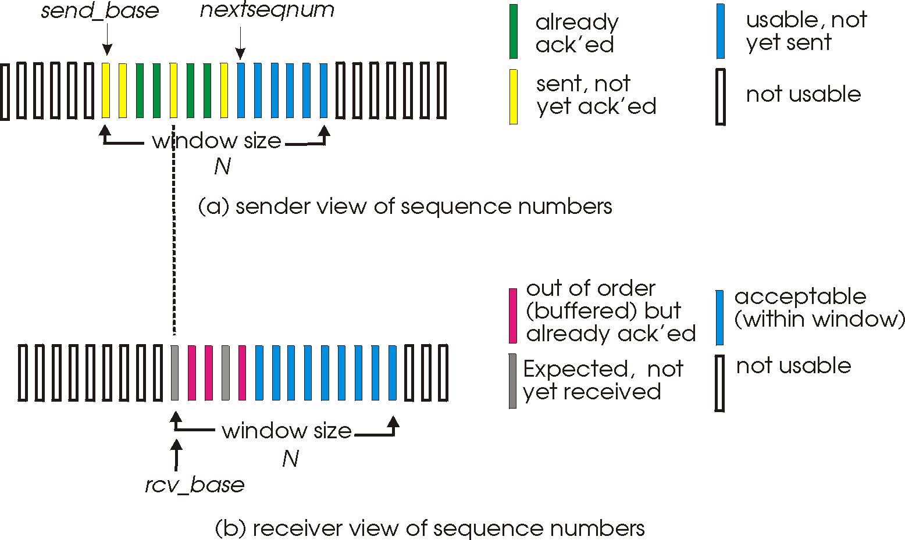
Selective repeat: sender, receiver windows

Slide 12
Selective repeat: sender and receiver
sender
receiver
data from above:
if next available seq # in window, send packet
timeout(n):
resend packet n, restart timer
ACK(n) in [sendbase,sendbase+N]:
mark packet n as received
if n smallest unACKed packet, advance window base to next unACKed seq #
packet n in [rcvbase, rcvbase+N-1]
send ACK(n)
out-of-order: buffer
in-order: deliver (also deliver buffered, in-order packets), advance window to next not-yet-received packet
packet n in [rcvbase-N,rcvbase-1]
ACK(n)
otherwise:
ignore
Notes:
If the packet is in order, its data will be delivered, as will any buffered data that can now be delived in order

Slide 13
Selective Repeat in action
sender window (N=4)
sender
receiver
0 1 2 3 4 5 6 7 8
send pkt0
send pkt1
send pkt2
send pkt3
(wait)
0 1 2 3 4 5 6 7 8
receive pkt0, send ack0
receive pkt1, send ack1
receive pkt3, buffer,
send ack3
0 1 2 3 4 5 6 7 8
X
0 1 2 3 4 5 6 7 8
loss
0 1 2 3 4 5 6 7 8
rcv ack0, send pkt4
0 1 2 3 4 5 6 7 8
rcv ack1, send pkt5
receive pkt4, buffer,
send ack4
record ack3 arrived
receive pkt5, buffer,
send ack5
pkt 2 timeout
0 1 2 3 4 5 6 7 8
send pkt2
(but not 3,4,5)
0 1 2 3 4 5 6 7 8
0 1 2 3 4 5 6 7 8
rcv pkt2; deliver pkt2,
pkt3, pkt4, pkt5; send ack2
0 1 2 3 4 5 6 7 8
Q: what happens when ack2 arrives?

Slide 14
Selective repeat: a dilemma!
sender window
(after receipt)
receiver window
(after receipt)
0 1 2 3 0 1 2
pkt0
0 1 2 3 0 1 2
pkt1
0 1 2 3 0 1 2
0 1 2 3 0 1 2
pkt2
0 1 2 3 0 1 2
example:
seq #s: 0, 1, 2, 3 (base 4 counting)
window size=3
0 1 2 3 0 1 2
0 1 2 3 0 1 2
pkt3
X
0 1 2 3 0 1 2
pkt0
will accept packet
with seq number 0
(a) no problem
0 1 2 3 0 1 2
pkt0
0 1 2 3 0 1 2
pkt1
0 1 2 3 0 1 2
0 1 2 3 0 1 2
pkt2
X
0 1 2 3 0 1 2
X
0 1 2 3 0 1 2
X
timeout
retransmit pkt0
0 1 2 3 0 1 2
pkt0
will accept packet
with seq number 0
(b) oops!

Slide 15

Selective repeat: a dilemma!
sender window
(after receipt)
receiver window
(after receipt)
0 1 2 3 0 1 2
pkt0
0 1 2 3 0 1 2
pkt1
0 1 2 3 0 1 2
0 1 2 3 0 1 2
pkt2
0 1 2 3 0 1 2
example:
seq #s: 0, 1, 2, 3 (base 4 counting)
window size=3
0 1 2 3 0 1 2
0 1 2 3 0 1 2
pkt3
X
0 1 2 3 0 1 2
receiver can’t see sender side
receiver behavior identical in both cases!
something’s (very) wrong!
pkt0
will accept packet
with seq number 0
(a) no problem
Q: what relationship is needed between sequence # size and window size to avoid problem in scenario (b)?
pkt0
0 1 2 3 0 1 2
0 1 2 3 0 1 2
pkt1
0 1 2 3 0 1 2
0 1 2 3 0 1 2
pkt2
X
0 1 2 3 0 1 2
X
0 1 2 3 0 1 2
X
timeout
retransmit pkt0
0 1 2 3 0 1 2
pkt0
will accept packet
with seq number 0
(b) oops!

Slide 16
Animation Link
https://www2.tkn.tu-berlin.de/teaching/rn/animations/gbn_sr/

Slide 17
Review
Pipelined Protocol
GBN
SR

Slide 18
GBN: sender extended FSM
rdt_send(data)
First, check if window is full,
if not send and update variables
N is the window size
base=oldest unack’ed
nextseqnum=seqno of next pckt
if (nextseqnum < base+N) {
sndpkt[nextseqnum] = make_pkt(nextseqnum,data,chksum)
udt_send(sndpkt[nextseqnum])
if (base == nextseqnum)
start_timer
nextseqnum++
}
else
refuse_data(data)
Timer associated with oldest unacked
base == nextseqnum, when?
Λ
base=1
nextseqnum=1
timeout
On timeout resend all
unack’ed packets
Wait
start_timer
udt_send(sndpkt[base])
udt_send(sndpkt[base+1])
…
udt_send(sndpkt[nextseqnum-1])
Why wait?
rdt_rcv(rcvpkt)
&& corrupt(rcvpkt)
Λ
Cumulative ACKs, receiver only
ACKs when packets delivered
in order.
Here we need to update base
and stop timer if nothing to send
or restart if some pckts left
rdt_rcv(rcvpkt) &&
notcorrupt(rcvpkt)
base = getacknum(rcvpkt)+1
If (base == nextseqnum)
stop_timer
else
start_timer

Slide 19
GBN: receiver extended FSM
default
udt_send(sndpkt)
rdt_rcv(rcvpkt)
&& notcurrupt(rcvpkt)
&& hasseqnum(rcvpkt,expectedseqnum)
Λ
Wait
extract(rcvpkt,data)
deliver_data(data)
sndpkt = make_pkt(expectedseqnum,ACK,chksum)
udt_send(sndpkt)
expectedseqnum++
expectedseqnum=1
sndpkt =
make_pkt(expectedseqnum-1,ACK,chksum)
ACK-only: always send ACK for correctly-received pkt with highest in-order seq #
may generate duplicate ACKs
need only remember expectedseqnum
out-of-order pkt:
discard (don’t buffer): no receiver buffering!
re-ACK pkt with highest in-order seq #
Notes:
In all other cases, the receiver discards the packet and resends an ACK for the most recently received in-order packet.

Slide 20

Chapter 3: roadmap
Transport-layer services
Multiplexing and demultiplexing
Connectionless transport: UDP
Principles of reliable data transfer
Connection-oriented transport: TCP
segment structure
reliable data transfer
flow control
connection management
Principles of congestion control
TCP congestion control

Slide 21
TCP: overview RFCs: 793,1122, 2018, 5681, 7323
point-to-point:
one sender, one receiver
reliable, in-order byte steam:
no “message boundaries"
full duplex data:
bi-directional data flow in same connection
MSS: maximum segment size
cumulative ACKs
pipelining:
TCP congestion and flow control set window size
connection-oriented:
handshaking (exchange of control messages) initializes sender, receiver state before data exchange
flow controlled:
sender will not overwhelm receiver
Notes:
between a single sender and a single receiver. The transfer of data from one sender to many receivers in a single send operation is not possible
Typical MSS is 1460 bytes

Slide 22
TCP connection
TCP connection consists of
Buffers and variables
a socket connection to a process in one host, and another set of buffers, variables, and a socket connection to a process in another host.
Nothing is stored in the network elements (routers, switches, and repeaters) between the hosts.
Notes:
TCP connection is logical one. NOT like TDM or FDM circuit as in Circuit switched networks in which states are reserved in intermediate nodes or elements. TCP connection is logical one where common states are only stored on end system. So intermediate nodes or routers have no idea about TCP connections.

Slide 23
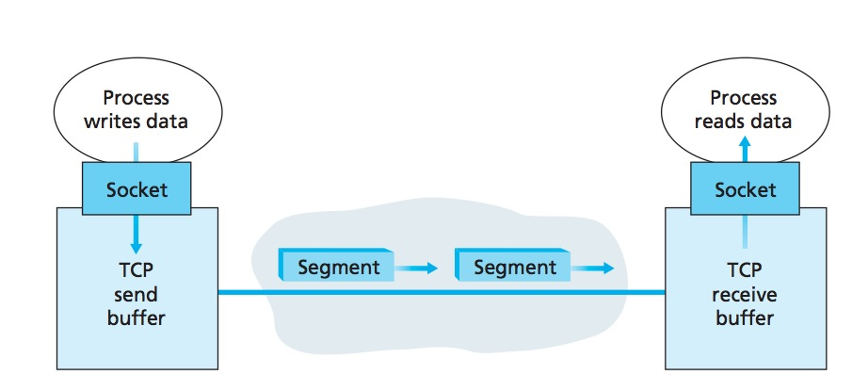
TCP Send/Receive buffers
The client process passes a stream of data through the socket.
Once the data passes through the Socket, the data is in the hands of TCP
running in the client.
TCP directs this data to the connection’s send buffer, which is one of the
buffers that is set aside during the initial three-way handshake.
From time to time, TCP will grab chunks of data from the send buffer and
pass the data to the network layer.
Notes:
Remember client process is one that initiates the connection.

Slide 24
TCP segment structure
32 bits
source port #
dest port #
segment seq #: counting bytes of data into bytestream (not segments!)
ACK: seq # of next expected byte; A bit: this is an ACK
sequence number
acknowledgement number
length (of TCP header)
head
len
not
used
A
P
S
receive window
flow control: # bytes receiver willing to accept
C
E
U
R
F
Internet checksum
checksum
Urg data pointer
options (variable length)
C, E: congestion notification
TCP options
application
data
(variable length)
data sent by application into TCP socket
RST, SYN, FIN: connection management

Slide 25
TCP sequence numbers, ACKs
outgoing segment from sender
Sequence numbers:
byte stream “number” of first byte in segment’s data
source port #
dest port #
sequence number
acknowledgement number
rwnd
checksum
urg pointer
window size
N
Acknowledgements:
seq # of next byte expected from other side
cumulative ACK
sender sequence number space
sent
ACKed
sent, not-yet ACKed
(“in-flight”)
usable
but not
yet sent
not
usable
Q: how receiver handles out-of-order segments
A: TCP spec doesn’t say, - up to implementor
outgoing segment from receiver
source port #
dest port #
sequence number
acknowledgement number
A
rwnd
checksum
urg pointer

Slide 26
Sequence Numbers
TCP views data as an unstructured, but ordered, stream of bytes.
Sequence numbers are over the stream of transmitted bytes and not over the series of transmitted segments.
The sequence number for a segment is therefore the byte-stream number of the first byte in the segment.

Slide 27
An example
A process in Host A wants to send a stream of data to a process in Host B.
The TCP in Host A will implicitly number each byte in the data stream.
For a file consisting of 500,000 bytes,
MSS being 1,000 bytes, and that the first byte of the data stream is numbered 0.
TCP constructs 500 segments out of the data stream.

Slide 28
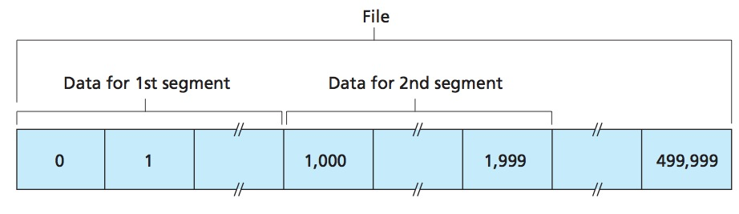
TCP Sequence Numbers
The first segment gets assigned sequence number 0, the second segment gets assigned sequence number 1,000, the third segment gets assigned sequence number 2,000, and so on.

Slide 29
Full duplex
TCP is full-duplex, so that Host A may be receiving data from Host B while it sends data to Host B (as part of the same TCP connection).
Data for B
A
Data for A
ACK
B
ACK

Slide 30
Acknowledgment numbers
A sends a segment to B, what would B put in the Ack sequence number in the next segment it sends to A?
next byte Host B is expecting from Host A.
A sends a segment to B, what would A put in the Ack sequence number in the next segment it sends to B?
next byte Host A is expecting from Host B.

Slide 31
An example
Host A has received all bytes numbered 0 through 535 from B.
Host A is waiting for byte 536 and all the subsequent bytes in Host B’s data stream.
What does Host A put in the acknowledgment number field of the next segment it sends to B?
Host A puts 536 in the acknowledgment number
field of the segment it sends to B

Slide 32
Another example
Host A has received all bytes numbered 0 through 535 from B.
Host A has also received another segment containing bytes 900 through 1,000
For some reason Host A has not yet received bytes 536 through 899.
What does Host A put in the acknowledgment number field of the next segment it sends to B?
A’s next segment to B will contain 536 in the acknowledgment
number field

Slide 33
Out of order segments
TCP only acknowledges bytes up to the first missing byte in the stream, TCP is said to provide cumulative acknowledgments.
For out of order segments it can either discard them or buffer them (the approach actually taken in practice)

Slide 34
The seg/ack numbers base
we assumed that the initial sequence number was zero.
In truth, both sides of a TCP connection randomly choose an initial sequence number.
Why?
Notes:
This is done to minimize the possibility that a segment that is still present in the network from an earlier, already-terminated connection between two hosts is mistaken for a valid segment in a later connection between these same two hosts (which also happen to be using the same port numbers as the old connection)

Slide 35
TCP sequence numbers, ACKs
Host A
Host B
User types‘C’
Seq=42, ACK=79, data = ‘C’
host ACKs receipt of‘C’, echoes back ‘C’
Seq=79, ACK=43, data = ‘C’
host ACKs receipt of echoed ‘C’
Seq=43, ACK=80
simple telnet scenario
Notes:
The key thing to note here is that the ACK number (43) on the B-to-A segment is one more than the sequence number (42) on the A-toB segment that triggered that ACK
Similarly, the ACK number (80) on the last A-to-B segment is one more than the sequence number (79) on the B-to-A segment that triggered that ACK

Slide 36
TCP round trip time, timeout
Q: how to set TCP timeout value?
longer than RTT
but RTT varies
too short: premature timeout, unnecessary retransmissions
too long: slow reaction to segment loss
Q: how to estimate RTT?
SampleRTT: measured time from segment transmission until ACK receipt
ignore retransmissions
SampleRTT will vary, want estimated RTT “smoother”
average several recent measurements, not just current SampleRTT

Slide 37
TCP round trip time, timeout
EstimatedRTT = (1- α)*EstimatedRTT + α*SampleRTT
exponential weighted moving average
influence of past sample decreases exponentially fast
typical value: α = 0.125
RTT: gaia.cs.umass.edu to fantasia.eurecom.fr
RTT (milliseconds)
sampleRTT
EstimatedRTT

Slide 38
TCP round trip time, timeout
timeout interval: EstimatedRTT plus “safety margin”
large variation in EstimatedRTT -> larger safety margin
estimate SampleRTT deviation from EstimatedRTT:
DevRTT = (1-β)*DevRTT +
β*|SampleRTT-EstimatedRTT|
(typically, β = 0.25)
TimeoutInterval = EstimatedRTT + 4*DevRTT
estimated RTT
“safety margin”

Slide 39
TCP reliable data transfer
TCP creates rdt service on top of IP’s unreliable service
pipelined segments
cumulative acks
single retransmission timer
Retransmissions triggered by:
timeout events
duplicate acks
let’s initially consider simplified TCP sender

Slide 40
TCP Sender (simplified)
event: data received from application
create segment with seq #
seq # is byte-stream number of first data byte in segment
start timer if not already running
think of timer as for oldest unACKed segment
expiration interval: TimeOutInterval
event: timeout
retransmit segment that caused timeout
restart timer
event: ACK received
if ACK acknowledges previously unACKed segments
update what is known to be ACKed
start timer if there are still unACKed segments
Notes:
Given these details of TCP sequence numbers, acks, and timers, we can now describe the big picture view of how the TCP sender and receiver operate
You can check out FSMs in book; let’s just give an English text description here and let’s start with the sender.

Slide 41
TCP sender (simplified)
data received from application above
create segment, seq. #: NextSeqNum
pass segment to IP (i.e., “send”)
NextSeqNum = NextSeqNum + length(data)
if (timer currently not running)
start timer
Λ
NextSeqNum = InitialSeqNum
SendBase = InitialSeqNum
wait
for
event
timeout
retransmit not-yet-acked segment with smallest seq. #
start timer
ACK received, with ACK field value y
if (y > SendBase) {
SendBase = y
/* SendBase–1: last cumulatively ACKed byte */
if (there are currently not-yet-acked segments)
start timer
}

Slide 42
TCP: retransmission scenarios
Host A
Host B
Host A
Host B
SendBase=92
Seq=92, 8 bytes of data
Seq=92, 8 bytes of data
timeout
timeout
Seq=100, 20 bytes of data
ACK=100
X
ACK=100
ACK=120
Seq=92, 8 bytes of data
Seq=92, 8
bytes of data
SendBase=100
SendBase=120
ACK=100
ACK=120
SendBase=120
lost ACK scenario
premature timeout

Slide 43
TCP: retransmission scenarios
Host A
Host B
Seq=92, 8 bytes of data
Seq=100, 20 bytes of data
timeout
ACK=100
X
ACK=120
Seq=120, 15 bytes of data
cumulative ACK

Slide 44
Modified TCP – Doubling Timeout Interval
Whenever the timeout event occurs it sets the next timeout interval to twice the previous value,
rather than deriving it from the last EstimatedRTT and DevRTT
However, in case of other two events (app data received or ACK received), it is derived.
It also provides a limited form of congestion control.
Timer expiration due to congestion
It is better to wait rather than keep sending
Notes:
For example, suppose TimeoutInterval associated with the oldest not yet acknowledged segment is .75 sec when the timer first expires. TCP will then retransmit this segment and set the new expiration time to 1.5 sec. If the timer expires again 1.5 sec later, TCP will again retransmit this segment, now setting the expiration time to 3.0 sec.

Slide 45
Modified TCP – Fast Retransmit
Timeout-triggered retransmissions can take long
Duplicate ACKs can help sender to detect packet loss
A duplicate ACK is an ACK that reacknowledges a segment for which the sender has already received an earlier acknowledgment.
When it is sent/received?

Slide 46

TCP fast retransmit
Host A
Host B
TCP fast retransmit
if sender receives 3 additional ACKs for same data (“triple duplicate ACKs”), resend unACKed segment with smallest seq #
likely that unACKed segment lost, so don’t wait for timeout
Seq=92, 8 bytes of data
Seq=100, 20 bytes of data
X
ACK=100
timeout
ACK=100
ACK=100
Receipt of three duplicate ACKs indicates 3 segments received after a missing segment – lost segment is likely. So retransmit!
ACK=100
Seq=100, 20 bytes of data
Notes:
Let’s wrap up our study of TCP reliability by discussing an optimization to the original TCP known as TCP fast retransmit,
Take a look at this example on the right where 5 segments are transmitted and the second segment is lost. In this case the TCP receiver sends an ACK 100 acknowledging the first received segment.
When the third segment arrives at the receiver, the TCP receiver sends another ACK 100 since the second segment has not arrived. And similarly for the 4th and 5th segments to arrive.
Now what does the sender see? The sender receives the first ACK 100 it has been hoping for, but then three additional duplicate ACK100s arrive. The sender knows that somethings’ wrong – it knows the first segment arrived at the receiver but three later arriving segments at the receiver – the ones that generated the three duplicate ACKs – we received correctly but were not in order. That is, that there was a missing segment at the receiver when each of the three duplicate ACK were generated.
With fast retransmit, the arrival of three duplicate ACK causes the sender to retransmit its oldest unACKed segment, without waiting for a timeout event. This allows TCP to recover more quickly from what is very likely a loss event
specifically that the second segment has been lost, since three higher -numbered segments were received

Slide 47
TCP Receiver: ACK generation [RFC 5681]
Event at receiver
arrival of in-order segment with
expected seq #. All data up to
expected seq # already ACKed
arrival of in-order segment with
expected seq #. One other
segment has ACK pending
arrival of out-of-order segment
higher-than-expect seq. # .
Gap detected
arrival of segment that
partially or completely fills gap
TCP receiver action
delayed ACK. Wait up to 500ms
for next segment. If no next segment,
send ACK
immediately send single cumulative
ACK, ACKing both in-order segments
immediately send duplicate ACK,
indicating seq. # of next expected byte
immediate send ACK, provided that
segment starts at lower end of gap
Notes:
Rather than immediately ACKnowledig this segment, many TCP implementations will wait for half a second for another in-order segment to arrive, and then generate a single cumulative ACK for both segments – thus decreasing the amount of ACK traffic. The arrival of this second in-order segment and the cumulative ACK generation that covers both segments is the second row in this table.

